Slide 1

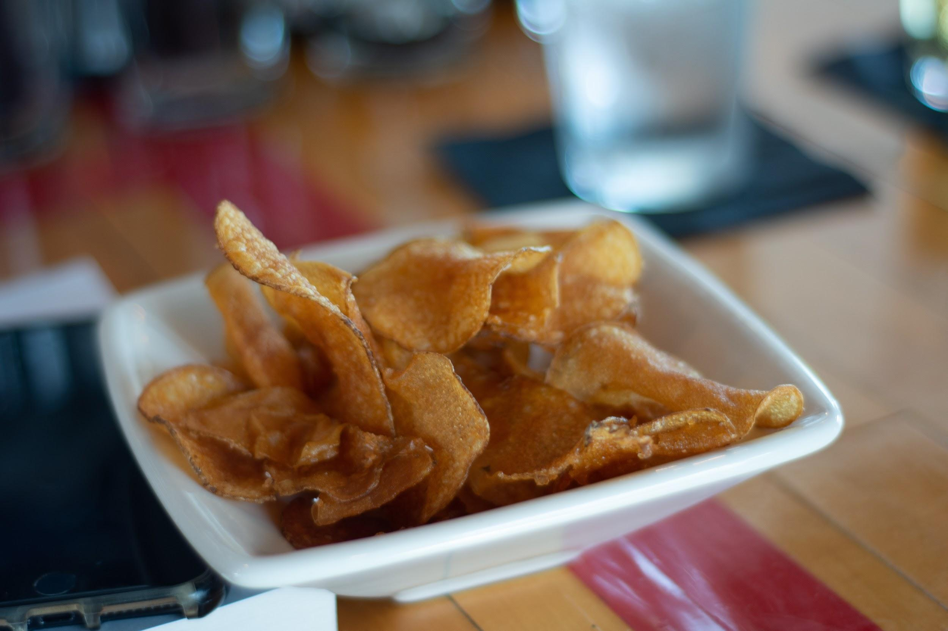

August 2019
Clark Consulting
Frito Lay Employee
Analysis
Notes:
Template Name: Title Slide with Partner Logos – White Headline Right Aligned
To apply the grid for the WS Logo + Partner Logo pull from the Template Grids at the end of this document.

Slide 2
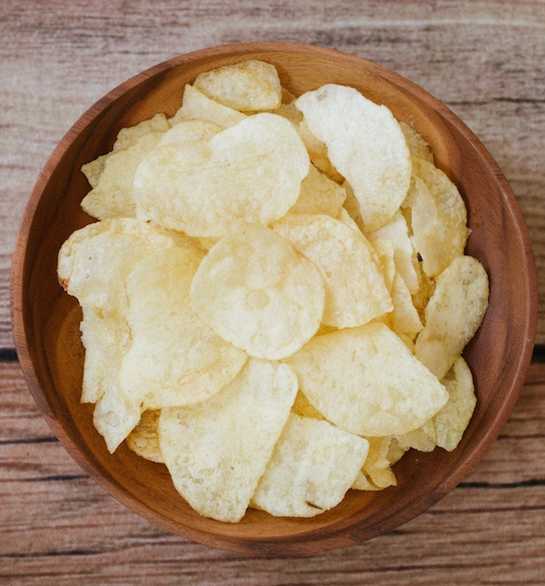
Outline
Business Question and Situation Analysis
Data Overview and Cleaning
Salary Prediction
Salary Variable Importance
Attrition Prediction
Attrition Variable Importance
Conclusion
Notes:
OLD outline:
Business Question and Situation Analysis
Data Overview and Cleaning
Breweries by the State
Combining and Merging Data
Addressing missing values
ABV and IBU by state
Max ABV and IBU
Summary of ABV data
ABV and IBU relationship
Conclusion and Implications

Slide 3
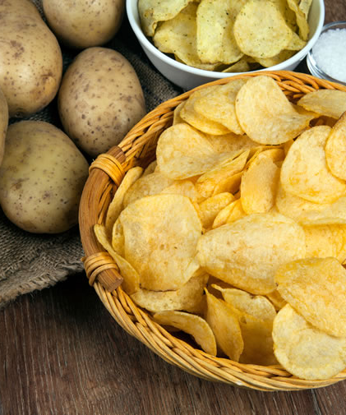
Potato Chips At a Glance
In 2016, the U.S. Potato Chip industry grew to $7.74 billion and is expected to grow consistently over the next 10 years.
With new competitors emerging in the industry, it’s important to ensure Frito Lay maintains top talent to maintain an edge
Research Question:
Identify a model to predict Attrition and Monthly Salary among the Frito Lay Employees.
https://www.grandviewresearch.com/industry-analysis/us-potato-chips-market

Slide 4
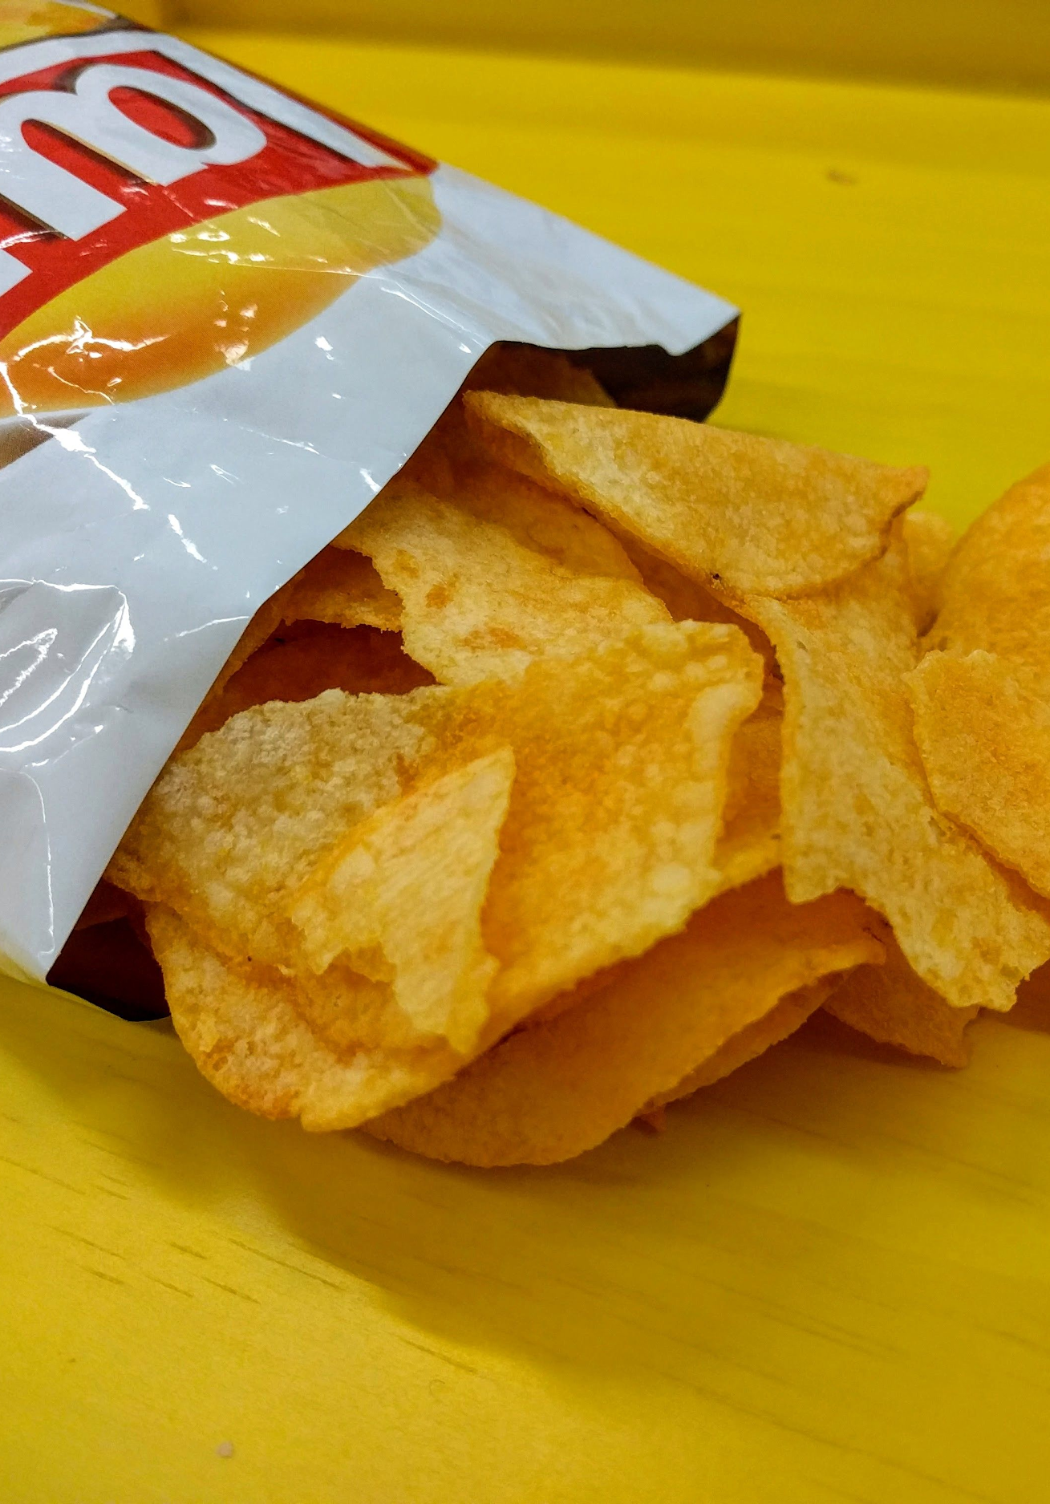
Data Overview
Data Available:
Traindata.csv - dataset with 870 different employees at Frito Lay with information on salary, performance and company sentiment.
TestSalary.csv - dataset of 300 employees with the same information as Traindata, but with Salary information removed for testing
TestAttrition - dataset of 300 employees with the same information as Traindata, but with Attrition information removed

Slide 5
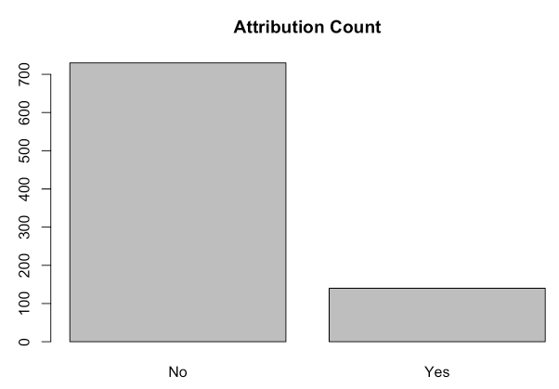
Employee Data Analysis
In the year of the study, employee attribution was roughly 16%
Notes:
California has a brewery every 4,200 sq mile

Slide 6
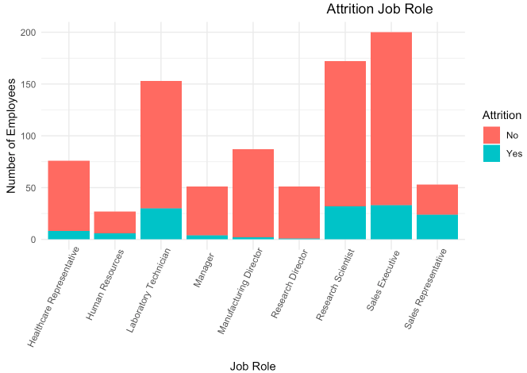
Employee Data Analysis
Attrition is the highest among Sales Executives and Laboratory Technicians.
Notes:
California has a brewery every 4,200 sq mile

Slide 7
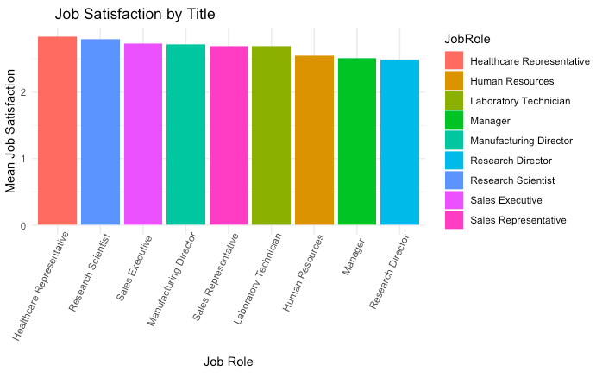
Employee Data Analysis
Healthcare Representative and Research Scientists have the highest Job satisfaction while managers have the lowest.
Notes:
California has a brewery every 4,200 sq mile

Slide 8
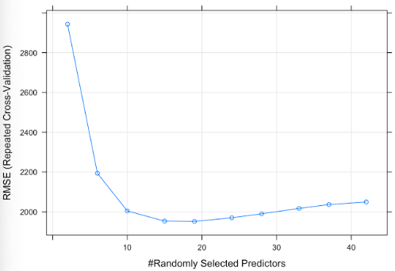
Salary Prediction
 | K Nearest Neighbor | Random Forest | Support Vector Method
RMSE | $2,299.51 | $1,951.66 | $2,035.27

Slide 9
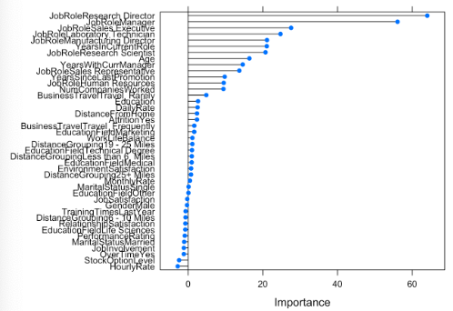
Salary Prediction Feature Importance
Top Indicators
Job Role
Years in Current Role
Age

Slide 10
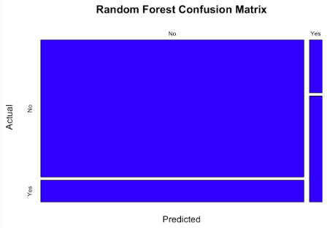
Attrition Prediction
 | Naive Bayes | Random Forest | Support Vector Method
Sensitivity / Specificity | 0.88 / 0.45 | 0.86 / 0.67 | 0.85 / 0.57

Slide 11
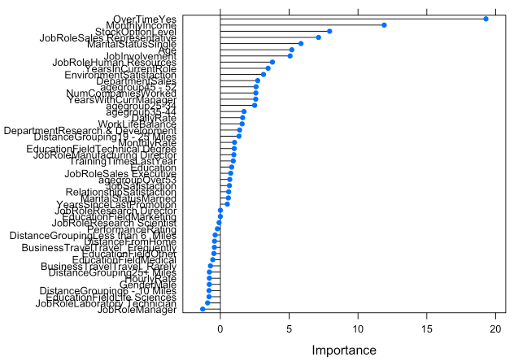
Attrition Feature Importance
Top Indicators
Overtime Workers
Monthly Income
Stock Option Level

Slide 12
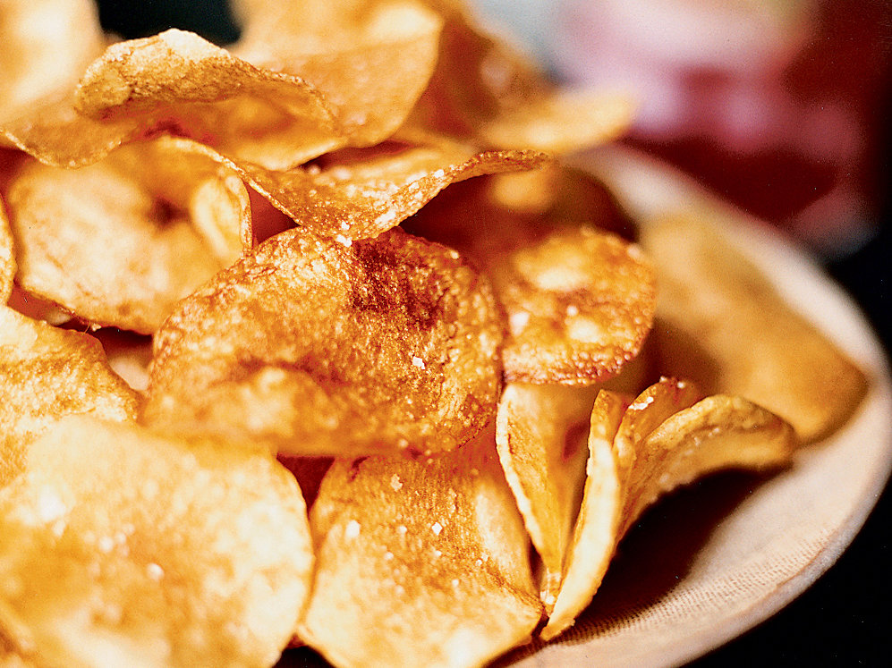
Conclusion
Employ the RF model to predict when new employees are meeting the indicators for high attrition and provide a counter offer to entice them to stay.
Employ the RF model to show employees how their salaries are slated to grow at a company to help them better control their futures.
Notes:
High-gravity = high ABV

Slide 13
Appendix
Notes:
Template Name: Title Slide with Partner Logos – White Headline Right Aligned
To apply the grid for the WS Logo + Partner Logo pull from the Template Grids at the end of this document.

Slide 14
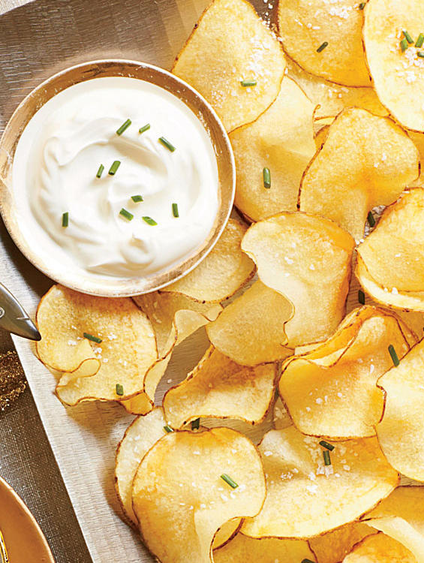
Salary Cleaning
Looking at the interaction rate of all the variables, we can see that the following variables show to have high collinearity per our model, which we can remove. For the variables where we are seeing high collinearity among categorical variables, we will leave in. This is all validated through our significant p value of <0.0001.
Below are the variables with high collinearity
Age/Age Group
Distance Grouping
Department

Slide 15
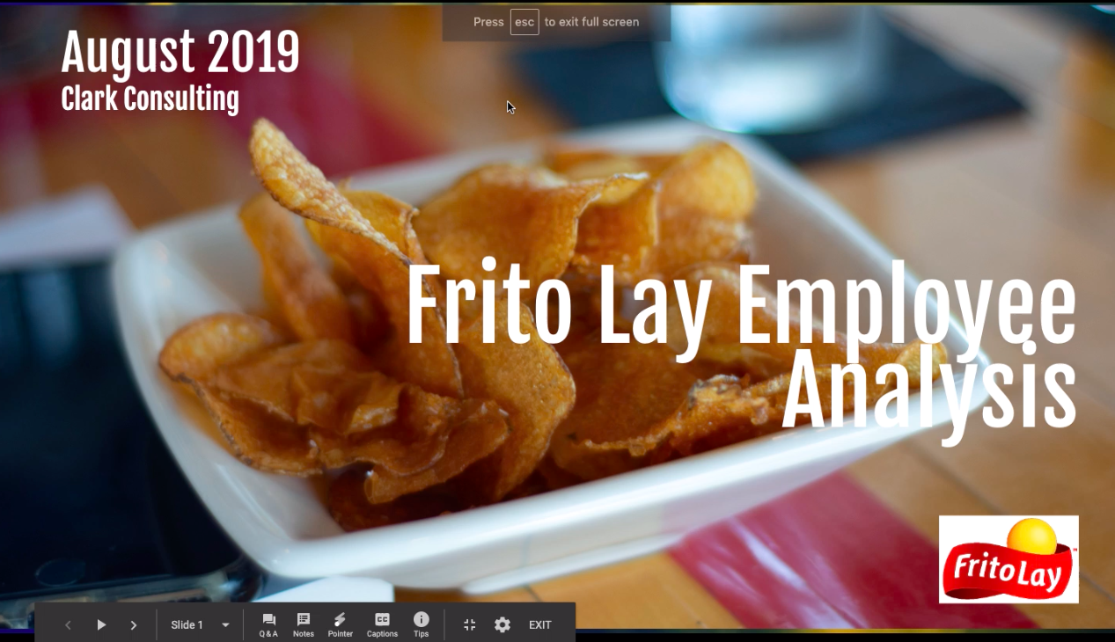
Presentation Videos
-Daniel Clark: https://youtu.be/YTCdQHtOVpw

